Slide 1
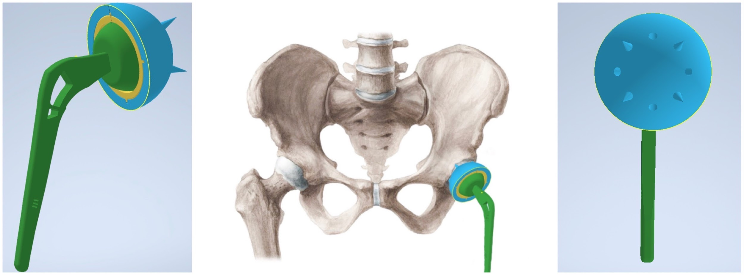
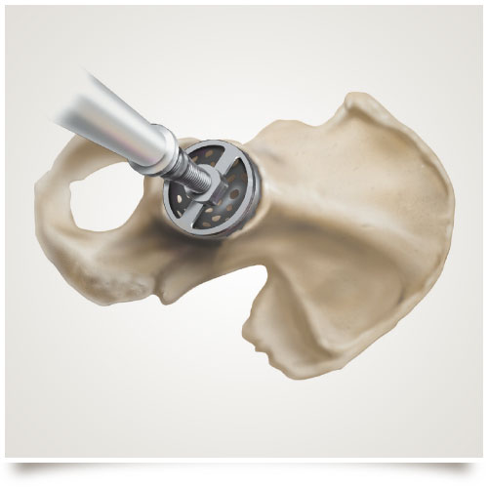
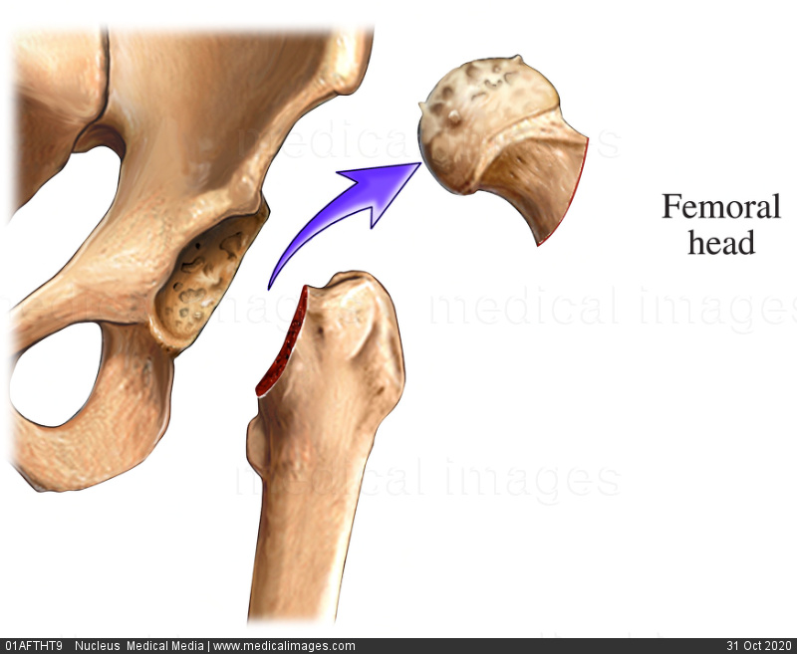
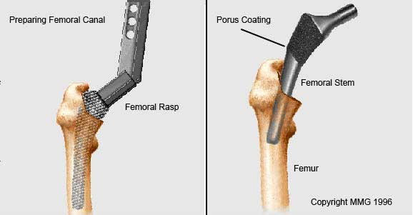
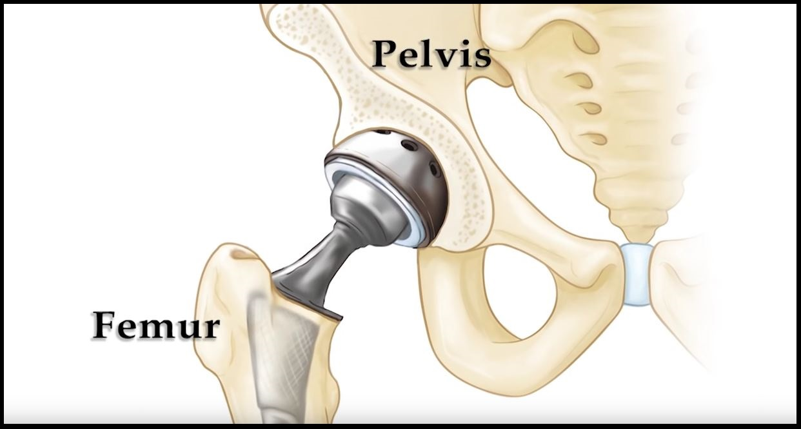
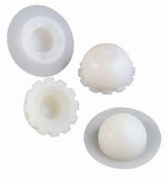
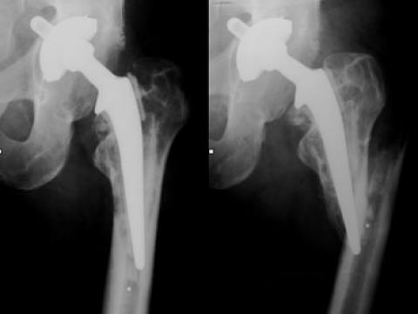
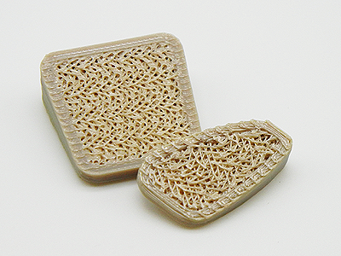
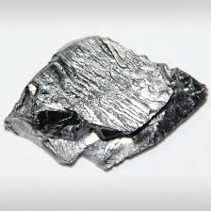
Arth-GROW-Plasty
A Part Of You Rather Then A Part In You
Kavya Sundaresan, Miguel Martinez Santos, Matthew Milkovich, Melaina Del Grosso
Figure (3): Shows how the CAD design fits the hip [2].
Dislocate hip and saw deformed femoral head from thigh bone.[18]
Hemispherical reamers shave off damaged cartilage and bone in 2mm increments until acetabulum has diameter of 80mm.[18]
Acetabular cup is attached via drilling into the hip bone and liner will be attached to the acetabular cup.[19]
Uncemented femoral head and stem will be hammered into the thigh bone after femur is reamed out.[19]
Patient Profile : Jackie Chiles
Surgical Fixation
Jackie Chiles is a 61-year-old retiree who has lived with movement induced hip pain for most of his life.
Pain began at age 10, developing a limp to relieve weight on left hip to reduce the pain.
Past physiotherapy, using a cane and daily pain relief medications, Tramadol and Oxycodone, have not been effective to reduce pain.
Jackie needs a costume hip replacement in order to reduce pain and restore motion.
R L
Acetabular Cup
Acetabular Liner
Acetabular Spikes
Femoral Head
Drill Holes
Femoral Neck
Femoral Stem
Arth-GROW-Plasty Design
Microscopic Fish Scales
Mobility
Maximizes biocompatibility and bone regrowth.
Innovative acetabular spikes to improve attachment to the acetabulum.
Built in drill holes to prevent rupturing of polymer.
Groves and holes to promote bone regeneration to increase weight support.
Microscopic fish scales uses biomimicking [3].
Restores femoral head to original position.
Restores center of rotation symmetric to the right leg.
Improves mobility and range of motion.
Smooth rotation of femoral head relieves motion induces pain.
Table(1): Examination of Hip Motion
Diagnosis: Legg-Calve-Perthes
Figure(7): Removal of femoral head[19]
Figure(8):Hemispherical Reamers[20]
Legg-Calve-Perthes disease: a childhood condition resulting from temporarily disrupted blood flow to femoral head [1].
Weakened bone will break apart resulting in non-spherical femoral head [1].
Materials
Imaging Indicators:
Mushroom shaped femoral head.
Acetabular Cup: PEEK reinforced with Aluminum Nitride
Liner: HDPE
Figure(9): Uncemented Stem[21]
Figure(10): Total Hip Replacement[22]
Elastic modulus: 0.565-1.5 GPa [7]
Ultimate strength: 7.6-43 MPa [7]
Wear rate: 0.0029 m³/Nm
Add Calcium Carbonate fillers [7]
Outer Layer on Femoral Head and Stem: Porous Tantalum
8
7
Elastic modulus: 2-20 GPa [11]
Ultimate strength 110-210 MPa [11]
Toughness: 7.57-9.89 MPa • m^{1/2} [11]
Wear rate: 0.000189 m³/Nm [11]
Osteogenesis properties [12]
Increase the corrosion [12] resistance of steel
Arth-GROW-Plasty Vs Commercial
Symptoms:
Left leg 1cm shorter.
Immense pain in left hip movement.
Reduced mobility
Symptoms from young age.
Promotes Osteointegration.
Uncemented.
Less likely to loosen.
50.6% of hip implants contain, ceramics, polyethylene, and cemented titanium stem.[23]
Often leads to loosening.[24]
Elastic modulus: 3.76-3.95 GPa [4]
Ultimate strength: 80 MPa [4]
Strengthen with Aluminum Nitride by increasing microhardness.[4]
Porous PEEK outer layer.
Osteogenesis properties; mimics bone structure [5]
Figure(1): Pelvic X-ray
Figure(11):Osteointegration[25]
Worn down acetabulum due to defective femoral head.
Larger diameter and shallower
Next steps: a spherical femoral head and properly fitted acetabular cup to restore mobility and relieve pain
Figure(12): Implant Loosening Failure[26]
Fig (5): HDPE Linner
References
Stainless Steel: Femoral Head and Stem
u
Elastic modulus: 193-200 GPa [9]
Ultimate strength: 505 MPa [9]
Low cost [9]
Works Cited
[1] “Legg-Calve-Perthes disease - Symptoms and causes - Mayo Clinic.” https://www.mayoclinic.org/diseases-conditions/legg-calve-perthes-disease/symptoms-causes/syc-20374343 (accessed Oct. 31, 2020).
[2] “Studying Fish to Design New Materials - MaterialDistrict.” https://materialdistrict.com/article/studying-fish-to-design-new-materials/ (accessed Oct. 31, 2020).
[3] “Pelvis-anatomy-anterior-view,” Medical-artist.com, 14-Sep-2018. [Online]. Available: https://www.medical-artist.com/anatomy-images/orthopaedic-illustrations/hip-pelvis-orthopaedic-illustrations/pelvis-anatomy-anterior-view/. [Accessed: 01-Nov-2020].
[4] W. by A. Z. M. M. 5 2003, “Supplier Data - Polyetheretherketone ( PEEK ) ( Goodfellow ),” 09-Jan-2018. [Online]. Available: https://www.azom.com/article.aspx?ArticleID=1882. [Accessed: 31-Oct-2020].
[5] F. B. Torstrick, D. L. Safranski, J. K. Burkus, J. L. Chappuis, C. S. Lee, R. E. Guldberg, K. Gall, and K. E. Smith, “Getting PEEK to Stick to Bone,” Techniques in Orthopaedics, vol. 32, no. 3, pp. 158–166, 2017.
[6] todd@fossilabs.com Todd Reith, “World's first 3D printed PEEK medical spinal implant with full porosity and advanced hydrophilicty promoting osseointegration,” FossiLabs, LLC., Industrial 3D PEEK printing, Todd Reith. [Online]. Available: https://fossilabs.com/. [Accessed: 31-Oct-2020].
[7] “Tribology of Polymers,” Nanovea, 21-Nov-2019. [Online]. Available: https://nanovea.com/tribology-of-polymers/.
[8] “Cemented or non-cemented acetabular prosthesis - CenatorTM - Corin.” https://www.medicalexpo.com/prod/corin/product-80816-698499.html (accessed Nov. 01, 2020).
[9] ASM Material Data Sheet. [Online]. Available: http://asm.matweb.com/search/SpecificMaterial.asp?bassnum=MQ304A. [Accessed: 31-Oct-2020].
[10] “New material mimics bone to create better biomedical implants,” ScienceDaily, 21-Feb-2010. [Online]. Available: https://www.sciencedaily.com/releases/2010/02/100216113603.htm.
[11] Q. Wang, H. Zhang, Q. Li, L. Ye, H. Gan, Y. Liu, H. Wang, and Z. Wang, “Biocompatibility and osteogenic properties of porous tantalum,” Experimental and Therapeutic Medicine, vol. 9, no. 3, pp. 780–786, 2015.
[12] V. K. Balla, S. Bodhak, S. Bose, and A. Bandyopadhyay, “Porous tantalum structures for bone implants: Fabrication, mechanical and in vitro biological properties,” Acta Biomater., vol. 6, no. 8, pp. 3349–3359, 2010, doi: 10.1016/j.actbio.2010.01.046.
[13] F. Matassi, A. Botti, L. Sirleo, C. Carulli, and M. Innocenti, “Porous metal for orthopedics implants,” May-2013. [Online]. Available: https://www.ncbi.nlm.nih.gov/pmc/articles/PMC3796997/.
[14] Z. Tang, Y. Xie, F. Yang, Y. Huang, C. Wang, K. Dai, X. Zheng, and X. Zhang, “Porous Tantalum Coatings Prepared by Vacuum Plasma Spraying Enhance BMSCs Osteogenic Differentiation and Bone Regeneration In Vitro and In Vivo,” PLoS ONE, vol. 8, no. 6, 2013.
[15] Interview conducted by Dr Andrew KennedyFeb 1 2012, “Porous Metals and Metal Foams - In Search of the 'Holey' Grail,” AZoM.com, 24-Jun-2019. [Online]. Available: https://www.azom.com/article.aspx?ArticleID=5940.
[16] S. Dittrick, V. K. Balla, S. Bose, and A. Bandyopadhyay, “Wear performance of laser processed tantalum coatings,” Mater. Sci. Eng. C, vol. 31, no. 8, pp. 1832–1835, Dec. 2011, doi: 10.1016/j.msec.2011.08.017.
[17] “Compare Niobium vs Tantalum: Compare properties,” Compare All Metals! [Online]. Available: https://metals.comparenature.com/en/niobium-vs-tantalum/comparison-62-57-0. [Accessed: 31-Oct-2020].
[18] “What is Hip Replacement? A Review of Total Hip Arthroplasty | UW Orthopedics and Sports Medicine, Seattle.” https://orthop.washington.edu/patient-care/articles/hip/what-is-hip-replacement-a-review-of-total-hip-arthroplasty.html (accessed Oct. 30, 2020).
[19] O. Rolfson, L. E. Dahlberg, J. Å. Nilsson, H. Malchau, and G. Garellick, “Variables determining outcome in total hip replacement surgery,” Journal of Bone and Joint Surgery - Series B, vol. 91, no. 2, pp. 157–161, Feb. 2009, doi: 10.1302/0301-620X.91B2.20765.
[20] X. W. Liu, Y. Zi, L. B. Xiang, and Y. Wang, “Total hip arthroplasty: A review of advances, advantages and limitations,” International Journal of Clinical and Experimental Medicine, vol. 8, no. 1. E-Century Publishing Corporation, pp. 27–36, Jan. 30, 2015, Accessed: Oct. 30, 2020. [Online]. Available: www.ijcem.com/.
[21] “Hip Replacement | Procedure, Symptoms, Types of Implants and Risks.” https://www.drugwatch.com/hip-replacement/ (accessed Oct. 30, 2020).
[22] “Total Hip Replacement - OrthoInfo - AAOS.” https://orthoinfo.aaos.org/en/treatment/total-hip-replacement/ (accessed Oct. 30, 2020).
[23] “Hip Replacement Materials Best to Worst.” https://www.bioxcellerator.com/blog/hip-replacement-materials-best-to-worst (accessed Oct. 31, 2020).
[24] C. Y. Hu and T. R. Yoon, “Recent updates for biomaterials used in total hip arthroplasty,” Biomaterials Research, vol. 22, no. 1. BioMed Central Ltd., Dec. 05, 2018, doi: 10.1186/s40824-018-0144-8.
[25] A. Nouri, P. D., and C. We, “Biomimetic Porous Titanium Scaffolds for Orthopedic and Dental Applications,” in Biomimetics Learning from Nature, InTech, 2010.
[26] “The Radiology Assistant : Arthroplasty.” https://radiologyassistant.nl/musculoskeletal/hip/arthroplasty (accessed Oct. 31, 2020).
[27] “Cemented or non-cemented acetabular prosthesis - CenatorTM - Corin.” https://www.medicalexpo.com/prod/corin/product-80816-698499.html (accessed Nov. 01, 2020).
Figure(2): Left Hip Joint X-ray
Fig (4): Porous PEEK
Fig (6): Tantalum

